Slide 2

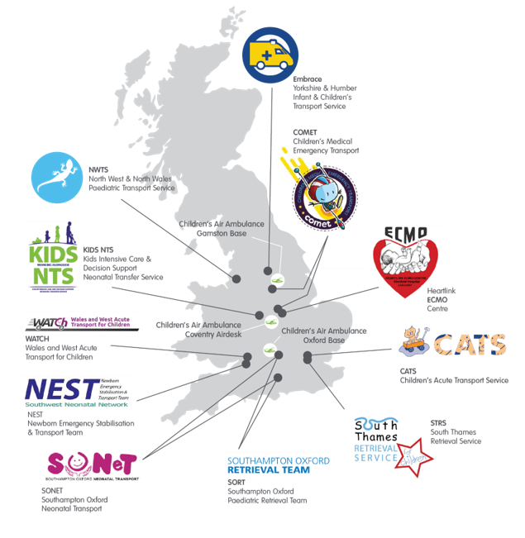
Children’s Air Ambulance
  National service providing inter-hospital transfers for critically ill babies, children and young people.
  First and only dedicated paediatric helicopter emergency transfer service in this country.
  Bespoke specialist equipment on board provides a flying intensive care unit for children.
  Work alongside 11 clinical partners across the UK.
  When a child is too sick to fly, the Children’s Air Ambulance will fly the specialist team to the child.
  Bases in Doncaster and Oxford.
Notes:
The Children’s Air Ambulance is a National inter-hospital transfer service for critically ill babies and children.
The service began as there was a need to get babies and children to the specialist care they needed, fast.
It is the first and only dedicated paediatric helicopter emergency transfer service in this country.
The children that we fly are often in a life or death situation, with illnesses that can’t be treated in a local hospitals because they don’t have the specialist knowledge and equipment.
The bespoke, specialist equipment on board provides a flying intensive care unit for our patients and a little later in this presentation, I’ll show you some images of the inside of the helicopter to help bring it to life.
We work alongside eleven clinical partners across the UK, as you can see on the map. These highly skilled teams, called retrieval teams, are employed by the NHS and work with us to manage the end to end transfer of our patients.
On every mission, we not only carry a doctor and nurse, but due to the complexity of the jobs and the length of time involved in the jobs – we fly with two pilots.
Sometimes, the patient is so poorly that it’s just too risky to move them. In this case, the helicopter will fly the specialist teams to the child to ensure they are given the best possible chance of survival.

Slide 3
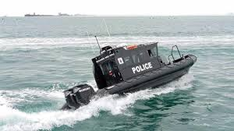
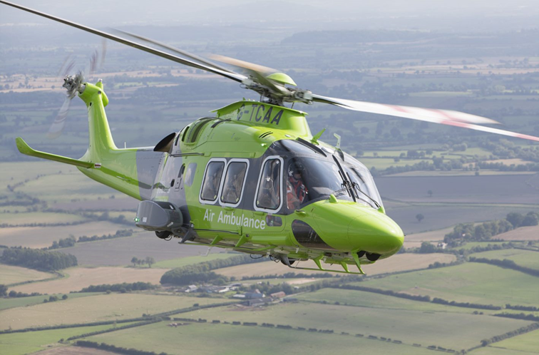
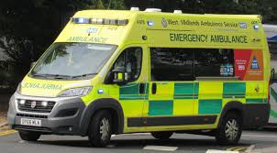
Guess the Fact!
What is Faster?
Agusta Westland 169
Top Speed: 165mph
Equipped with weather radar

Slide 4
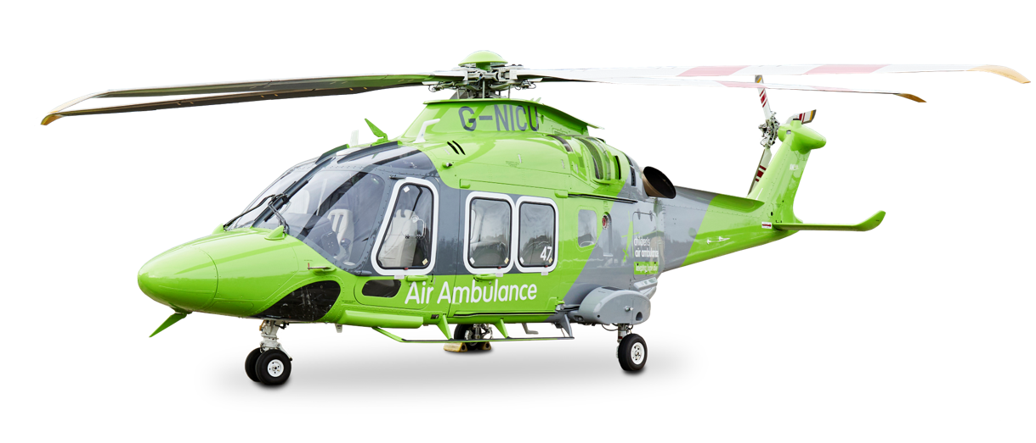
Guess the Fact!
What is Faster?
Top Speed of 165MPH - that’s over x2 the average speed of a land ambulance!
Notes:
Both of our new helicopters – Agusta Westland 169’s – have been specially designed to ensure all the teams we work with can give the best care to children in the air.
They have a top speed of 165 mph, as the crow flies.
And each are equipped with a weather radar, which means the pilots can plan the journey avoiding any bad weather that may develop on route.
Our helicopters are smoother and faster than road journeys, giving our patients the best chance of surviving.

Slide 5
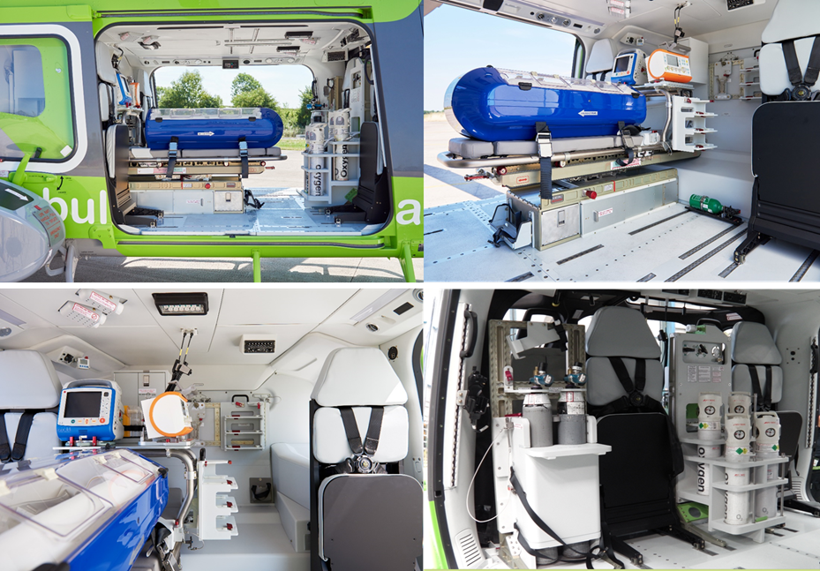
Children’s Air Ambulance
Designed to suit the needs of the child and crew
Specialist stretcher and Baby Pod
Parents can now fly with child
Notes:
As I mentioned previously, the interior of the helicopter has been designed to suit the needs of the child and crew. The stretcher is placed in the centre of the aircraft, which gives our clinical partners more mobility so they can focus on caring for the patient.
Working with our clinical partner teams, we also created a specialist stretcher and baby pod. It has been designed for us to be able to load babies and children on to our aircraft easily and it also integrates with a specialist fluid and oxygen system, meaning we can deliver vital fluids and air for our little patients. We truly are an intensive care unit in the air.
What’s also great about this aircraft is that a parent can now fly with their child which, as I’m sure you can imagine, is a huge relief for them. Our previous helicopter didn’t have space to take parents on board.

Slide 6
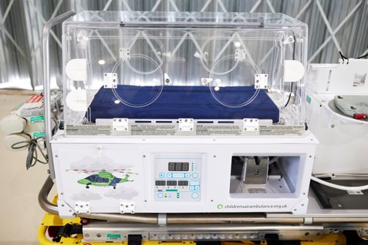
Children’s Air Ambulance - Incubators
Designed to suit the needs of the child and crew
We have England’s first and only incubator on a helicopter to assist specialist NSH transports teams during lifesaving flights.
Specialist stretcher and Baby Pod
Parents can now fly with child
Notes:
We have England’s first and only incubator on a helicopter to assist specialist NSH transport teams during lifesaving flights. All of these Neonatal Transport Systems have been designed with input from leading neonatal transfer clinicians to ensure they are able to provide outstanding care in the air.

Slide 7
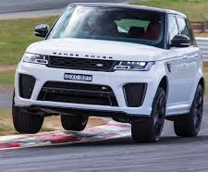
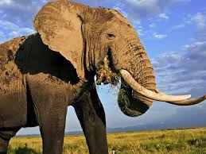
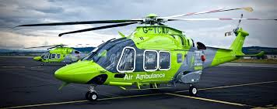
Guess the Fact!
Which is Heavier?

Slide 8
Guess the Fact!
What is Heavier?
Our Helicopters when fully loaded are around 5 tonnes in weight which is about the average weight of a teenage elephant!
Notes:
Both of our new helicopters – Agusta Westland 169’s – have been specially designed to ensure all the teams we work with can give the best care to children in the air.
They have a top speed of 165 mph, as the crow flies.
And each are equipped with a weather radar, which means the pilots can plan the journey avoiding any bad weather that may develop on route.
Our helicopters are smoother and faster than road journeys, giving our patients the best chance of surviving.

Slide 9
Guess the Fact!
How much do our missions cost?
£1700
£3500
£600
Notes:
Both of our new helicopters – Agusta Westland 169’s – have been specially designed to ensure all the teams we work with can give the best care to children in the air.
They have a top speed of 165 mph, as the crow flies.
And each are equipped with a weather radar, which means the pilots can plan the journey avoiding any bad weather that may develop on route.
Our helicopters are smoother and faster than road journeys, giving our patients the best chance of surviving.

Slide 10
Guess the Fact!
How much do our missions cost?
£3,500
Notes:
Both of our new helicopters – Agusta Westland 169’s – have been specially designed to ensure all the teams we work with can give the best care to children in the air.
They have a top speed of 165 mph, as the crow flies.
And each are equipped with a weather radar, which means the pilots can plan the journey avoiding any bad weather that may develop on route.
Our helicopters are smoother and faster than road journeys, giving our patients the best chance of surviving.

Slide 11


How your money helps
£10
Could help towards fuel for a lifesaving mission..
£24
Pays for a pair of children’s ear defenders to protect little ears from our noisy rotors.
£40
Pays for 2,400L oxygen to be carried on board, helping critically ill children breathe.
£3,500
Pays for an entire mission

Slide 12



#TheCrew – what is it?
Exciting club for children and young people where you can learn new skills, have access to special events and support TCAA.
Completely free to join.
Encourages children to develop their own fundraising ideas.
#TheCrew members receive a welcome pack, containing:
  Fundraising toolkit,
  Membership card and lanyard,
  Newsletter,
  Stickers.
All we ask is that each member tries to raise £25 for each year they are with us.
Silver, Gold, Platinum and Highflyers membership level, each come with additional rewards.
Notes:
If a child would like to get involved, they will need to ask their grown-up to visit our website to complete the registration form : https://theairambulanceservice.org.uk/childrens-air-ambulance/the-crew/

Slide 13


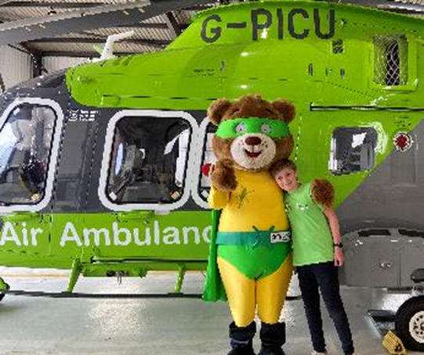
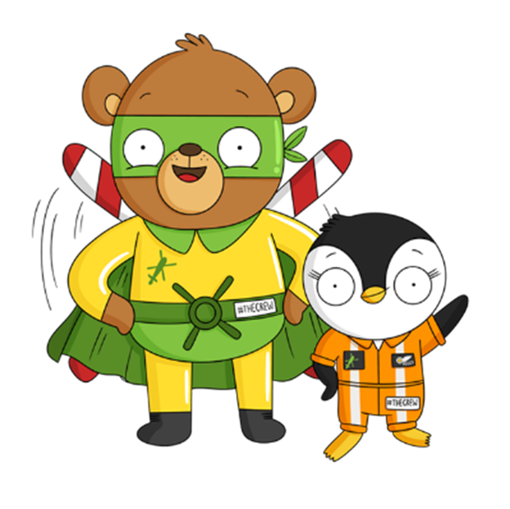
#TheCrew – what are the benefits?
Benefits for members:
  Quarterly newsletter through the post.
  Opportunity to achieve new levels of membership, each coming with exciting rewards.
  Develop skills and learn new things.
  Talks in schools as well as a visit from our Mascot.
  Access to members only webpage (Members only App coming soon too).
  Support from central team.
Benefits for schools:
  Talks/assemblies.
  Visits from Blade to school fairs etc.
  Careers talks.
  Advice and training on various aspects of community work.
  Re-use of old phone/IT equipment and/or textiles.

Slide 14









Get Involved
Charity of the Year
Partnerships
Fundraising
Events
Giftaid
Volunteer
Data Wiping
Service
Make a Donation
Recycle - Reuse
Shop with us
Part of The Air Ambulance Service. Registered in England and Wales as a limited company by guarantee. Registered Company No. 4845905. Registered Charity No. 1098874.
Notes:
Our helicopters launching are only half of the story and to help keep then flying we need you to help us. Everything you do for us, from simply having me along to your meeting to tell you about the Children’s Air Ambulance is a great way to show support to making a small donation makes a huge difference to little ones we fly. You don’t always have to give money to support a charity, never underestimate the spreading the word about the children’s air ambulance or even to volunteering to fundraise.
There are so many ways you can get involved and help to support the Children’s air ambulance so that they can continue to be there for patients in their greatest hour of need.
Charity Partnerships
You can nominate the Children’s Air Ambulance as a charity of the year, helping to promote the work of both our charity, your group and the work that we do together to help people in the community and across the United Kingdom.
Fundraising events
Alternatively, you could hold a fundraising event. Whether that’s a hosting a special fundraising lunch, bake sale, raffle or open garden.
Volunteering – one for the grown-ups
If you have some time to spare, you could help make a difference. Why not donate your time, and volunteer with us. We have lots of exciting volunteering opportunities coming up in 2023.
Data Wiping
We now have the ability to take laptops/computers and securely wipe them and then sell them on to raise funds for the charity. This data wiping service is offered for free.
Donations
Either monetary or unwanted goods. Monetary donations can be made online. Unwanted items can be dropped off at any of our retail stores. We even offer free furniture or large items collection in some areas. You can find out where your closest store is, or how to donate online via our web page.
Recycling
You can also choose to recycle your unwanted items. We have over 700 recycling bins placed throughout the country and your old clothes could make a huge difference. To find your nearest recycling bank, visit the website, or give us a call.
Shop with Us
Shop until you drop and help raise funds to keep our service flying. We have over 60 stores across the UK selling new and preloved items, with plans to open even more. You can also buy online through our Amazon and Ebay shops. Visit our website to find your nearest store. Visit the Landing Pad Cafe in one of our ‘Hanger’ super stores, where your brew fuels our crew!
Gift Aid
Donating through Gift Aid means charities can claim an extra 25p for every £1 you give. This also applies to pre-loved items donated in our stores. If you have grown-ups sponsoring you, ask them to gift-aid it.

Slide 15








Get in Touch
www.childrensairambulance.org.uk
fundraising@childrensairambulance.org.uk
@TheChildrensAirAmbulance
@ChildrensAirAmb
@ChildrensAirAmb
0300 3045 999
Children’s Air Ambulance
Blue Skies House
Butlers Leap
Rugby
Warwickshire
CV21 3RQ
Part of The Air Ambulance Service. Registered in England and Wales as a limited company by guarantee. Registered Company No. 4845905. Registered Charity No. 1098874.
Notes:
If you wish to get in touch with us, give us a call or email. If you would like to keep up to date with the charity news from missions to fundraising activities, follow our socials or visit our website.

